Slide 1
Outsourcing the Classroom to Ed Tech & Machine-learning: Why Parents & Teachers Should Resist
#NPE18INDY
October 20, 2018
Leonie Haimson, Class size Matters
Audrey Watters, Hack Education
Peter Greene, Curmudgucation

Slide 2
Privatization comes in many forms – all of them happening now
More privately run but publicly funded charter schools
Expansion of vouchers and tax credits going to fund private & religious schools
Proliferation of online learning, in which instruction, assessment and behavior management outsourced into hands of private vendors.

Slide 3
Sometimes different forms of privatization happen together….
Rocketship charters uses Dreambox software, co-owned by Rocketship John Danner and Netflix founder Reid Hastings

Slide 4
Since 2009, there’s been a loss of teaching jobs - now a gap of nearly 400K– leading to class size increases

Slide 5
Gates pushed standardizing education and making it more efficient through Common Core, inBloom and proliferation of ed tech “tools”
Gates-funded $100M data collection project called inBloom -- only part of much larger effort to mechanize education
Every student would have personal data collected over time while plugged into online curriculum with every component tagged with a specific Common Core standard
Gates spent over $500M on Common Core not because standards were better, or more rigorous but b/c standardizing them nationwide would allow for a uniform “outlet” that every kid and every curriculum could be plugged into
“If you have 50 different plug types, appliances wouldn’t be available and would be very expensive.” But once an electric outlet becomes standardized, many companies can design appliances and competition ensues, creating variety and better prices for consumers, he said.
STATE STANARDS

Slide 6
Yet this Rube Goldberg concept of education doesn’t work!
Larry Berger, head of Amplify, who came up with idea for inBloom said “I spent a decade believing in this model—the map, the measure, and the library, all powered by big data algorithms.”
“Here’s the problem: The map doesn’t exist, the measurement is impossible, and we have, collectively, built only 5% of the library.”
Not only is the human mind too complex but learning best takes place in a social context. Students learn best from interacting with teacher and their peers.

Slide 7
Only real way to “personalize” learning is to reduce class size, yet elected officials, private industry and venture philanthropists have promoted instruction through machines instead
Called “virtual learning”, “blended learning” or “personalized learning” all basically meaning same: substituting human interaction with teachers or fellow students with time spent on computers for part or most of the school day
After great recession, Bill Gates, Arne Duncan & others advised districts to take advantage of budget shortfalls by increasing class size
Teachers are too expensive and can be unruly; instead they claimed education was an engineering problem with a engineering solution.

Slide 8
Global investment in ed tech has risen steadily…
Source: "The 2017 Global Learning Technology Investment Patterns." Metaari Advanced Learning Technology Research.

Slide 9
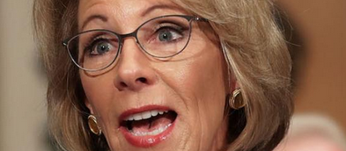
Government and industry support
US ED provided half billion dollars to fund expansion of online learning under Ed Sec Arne Duncan & created “Future Ready” pledge signed onto by more than 3100 Superintendents
Betsy Devos supports online education & invested in K12 Inc. company selling coursework to online charter schools & home-schooling parents. She still holds stocks in Neurocore brain training company touted as helping kids w/disabilities
Mark Zuckerberg is spending hundreds of millions on ed tech via his for-profit LLC Chan Zuckerberg Initiative, including on Summit personalized learning platform. Just announced: Summit PLP will spin off into new corporation with board of directors including his wife, Amy Chan and the CZI CFO, who will help guide it to “sustainability.”

Slide 10
Duncan and Gates created “Future Ready” Schools
“Future Ready Schools districts work with necessary stakeholders to ensure that all students and educators across the district have regular access to devices for learning.”
“How much time will it take for the district to complete the transition to digital learning?
The truthful answer to this question is that a district will probably never be “finished.”

Slide 11
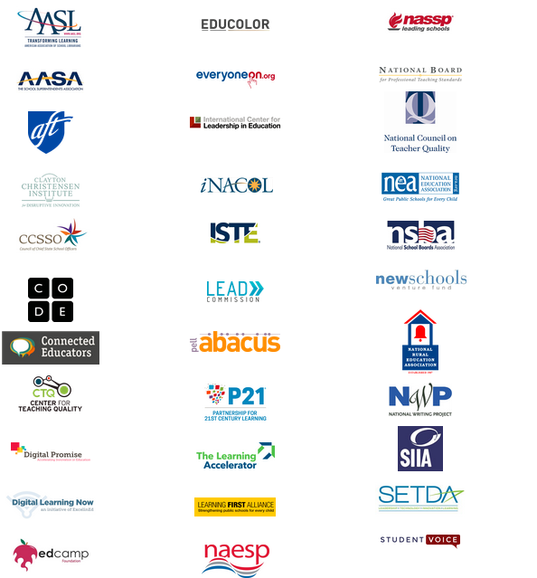
Organizations & companies working w/ “Future Ready” to promote online learning

Slide 12
Hype around online programs far transcends any evidence of effectiveness
Little or no evidence to prove their effectiveness; and when there is negative evidence its suppressed
Foundations, the advocacy groups they fund, media and ed tech industry all collaborate in a huge PR effort
Only 11% of district/school officials in charge of purchasing ed tech say they insist on any independent peer-reviewed research before buying a product.

Slide 13
Each new faddish digital program massively promoted… until reality sets in
NY Times called 2012 “Year of the MOOC”; two years later explained why it hadn’t worked for most students

Slide 14
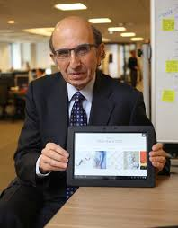
Rupert Murdoch was bullish on ed tech
“When it comes to K 12 education, we see a $500 billion sector in the U.S. alone that is waiting desperately to be transformed by big breakthroughs," he said in 2009.
He bought Wireless Generation in 2010, renamed it Amplify, and put Joel Klein in charge
Joel Klein said Amplify Tablet is “going to transform the way teachers teach and students learn”

Slide 15
What Happened? … until one month into the Within a month of its introduction in Guilford NC schools, 1500 screens broke and batteries melted in 75 more
1500 screens in 1500 Guilford NC broke screens & batteries melted

Slide 16
In 2015 Murdoch ends up selling Amplify at a loss of over $400 M

Slide 17
Alt School, a blended learning private school chain of 8 schools founded by a former Google executive with over $100M from investors like Mark Zuckerberg

Slide 18
“We’ve literally built an operating system for a 21st century school system,” founder Max Ventilli said in 2015.
Profiled in Wired, New Yorker, Public Radio in 2015-2016.
“Though the company touts the magic of its technology, two parents said their children benefited more from the extensive attention of talented teachers and small class sizes. “
By 2017, Ventilli closed four of his schools and said instead he would focus on instead on selling his technology to other schools .

Slide 19
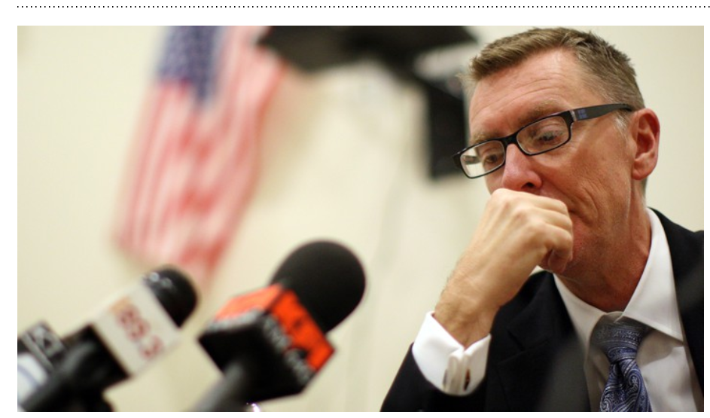

Slide 20
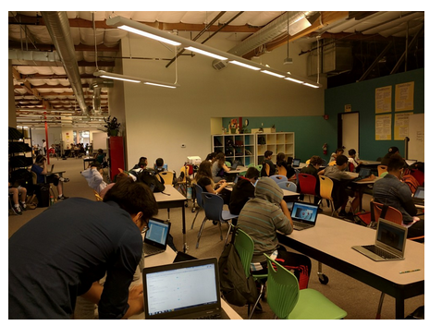
Summit p
Online Personalized Learning Platform
Summit charter schools based in CA introduced an online platform in 2010 to deliver curriculum and instruction with funding from $1M + from Gates
Summit partnered with Facebook in 2014 and now subsidized and engineered by Chan-Zuckerberg Initiative LLC
Students assigned "playlists" of online curriculum & assessments to complete on their own & at their own pace
Initially parents had right to consent for Summit to collect & disclose their children’s data but after CZI involved, that right was eliminated
This year, Summit PLP expanded to more than 300 schools across the country, both charter and public

Slide 21
Sample student dashboard

Slide 22
Summit collects voluminous student data & shares w/ up to 18 corporate “partners” including CZI
Contact information: name, email, username & passwords;
Attendance & disciplinary records including suspensions & expulsions
Race, ethnicity & economic status
Student work in video, audio, text & course progress;
Test scores, grades & standardized test results;
Grade level promotion, HS graduation, SAT scores, college acceptance & attendance& employment.
Academic or extracurricular activities a student may belong to or participate in.

Slide 23
Parent and student discontent at many schools using Summit PLP
Students don’t get enough personal feedback from teachers; suggested 15 min per week from “mentors” but sometimes less
Parents say their kids are bored & begin to hate school, fall behind on their assignments
Some parents have pulled their kids out of school, moved to another district or homeschooling
“No idea how disengaged this program would have my daughter from school…. She has always been an easy kid that enjoys school. This year? …she doesn’t want to go. It’s booorrriiinnnggg. She needs that teacher engagement to hold her attention. Computer screen doesn’t cut it.”
“Within weeks my son started coming home from school upset and didn’t want to go to school. He said that he didn’t like being taught by a computer and sitting in front of a computer watching videos and taking notes all day. He was basically in charge of his own education at the age of 12. “

Slide 24
Yet evidence for Summit and online learning weak
CREDO study shows students in full-time online charter schools fell behind peers, with 180 fewer days of learning in math and 72 fewer days in reading.
Gains in math were so small, it was "literally as though the student did not go to school for the entire year”
According to a CREDO 2017 analysis , Summit charter students showed no significant gains in and a small but significantly negative effect in math
RAND researcher, John F. Pane, has said the evidence for personalized learning is still “very weak.”

Slide 25
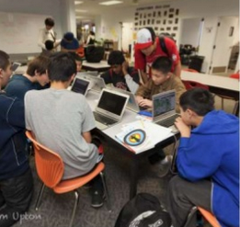
2017 RAND study
Examined more select group of 32 Personalized Learning schools w/ Next Generation Learning Challenge grants from Gates etc. including Summit
Gains on tests tiny; 0.09 SD in math & 0.07 in reading; only math significant.
71% students say that they are bored vs 58% of national sample

Slide 26
Students at NGLC schools were less likely to feel safe Less likely to say there is one adult at school who knows them well Less likely to feel an important part of their school community
Pane, John F., et. al. Informing Progress: Insights on Personalized Learning Implementation and Effects. RAND Corporation, July 2017.

Slide 27
Huge threat to student privacy as data outsourced into hands of corporations
FERPA was weakened twice- under Bush and Obama – to allow for expanded disclosure to corporations & organizations w/o parental consent
Future of Privacy funded by ed tech industry and Gates etc. created a voluntary “student privacy pledge” that many companies have signed but is not enforceable
College Board signed pledge though they sell student data and allow it to be used for marketing purposes; Facebook (and CZI ) signed pledge though FB has repeatedly violated privacy, triggering legal complaints but no action by the FTC
Data breaches have multiplied hugely and many of the most-used apps use data for advertising purposes
EdModo- acquired by a Chinese company – has done both.

Slide 28
As education employs AI to create “black box” algorithms directing instruction in schools
Algorithms: little or no transparency and may reinforce biases and discrimination
More surveillance of students and teachers
Does it increase the self-determination and opportunities of the students & teachers it targets?
Would technocrats who support it want it used on their own children?*
[*adapted from questions asked by sociologist Virginia Eubanks]

Slide 29
Now there’s a push to use Amazon Echo & other internet connected devices in schools

Slide 30
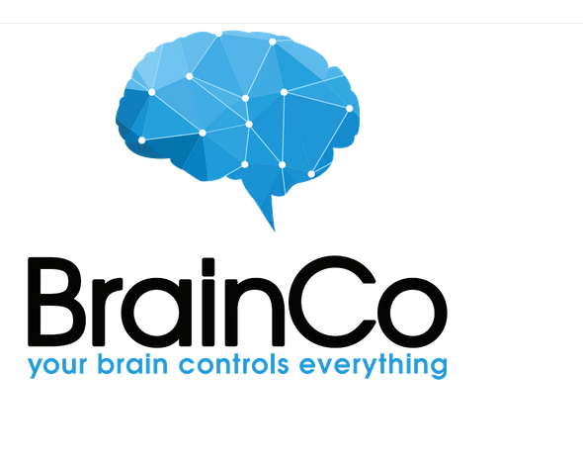
Headbands to measure and report student EEGs to teacher dashboard to oversee their attention levels.
Developed at Harvard Innovation Labs, company has received $15 million in venture funding from Chinese investors

Slide 31
Recalls 1910 illustration by Villemard, imagining schools “In the Year 2000”
https://www.urbanghostsmedia.com

Slide 32
UPSTART online preK – used in 6 states and by 30% of 4 year old students in Utah
PreK students not exempt from online learning

Slide 33
Even Finland is piloting robot teachers in classrooms

Slide 34
So what can parents/teachers do to push back?
Organize, organize, organize in your school, district or state.
Parents in all nine states/districts beat inBloom despite NO funds and little support from mainstream privacy advocacy groups
Over 250 NEW state student privacy laws passed since 2014 as a result of the ensuing controversy.
Parent Cindy Eckard of Screens and Kids advocated for new MD law HB1110, requiring MD Departments of Education & Health to draft health and safety best practices for use of technology in classrooms.
Remember: Online learning is a vast, unregulated experiment; and no generation of children has ever been exposed to this much computer screen time at home or at school.

